Slide 1

STOCKS DASHBOARD ANALYSIS
By ProCapitas

Slide 2

KEY STAKEHOLDERS
Organisation
ProCapitas
Teams
Analytics department
Finance department
Client

Slide 3
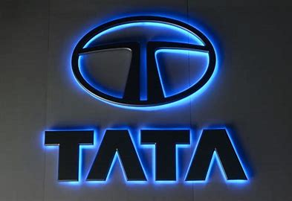
BACKGROUND
TATA MOTORS
Tata Motors Limited is an Indian multinational automotive company, headquartered in Mumbai and part of the Tata Group. The company produces cars, trucks, vans, and buses.
PERFORMANCE
The stock price has increased by +4.30% in the last 52 weeks. The beta is 1.68, so Tata Motors's price volatility has been higher than the market average. In the last 12 months, Tata Motors had revenue of INR 4.40 trillion and earned 333.41 billion in profits. Earnings per share was 96.94.

Slide 4
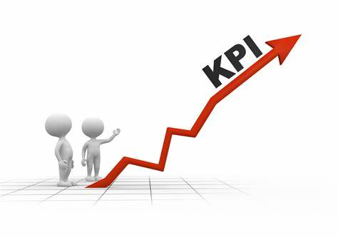
WHAT AND WHY KPI IN DASHBOARD ?
Average 52 week high and low = So clients are able to judge historical performance of stocks.
Average High and Low = Average high and low are on the basis of recent day to day trading. The measure is used for client in order to make comparison and decision that whether it is right for investor to invest or not.
Average Open and Close = Is used so that the client is informed about at what price or jump is in opening or closing price.
Average Ltp and VWAP = Is used so that the client is informed about last trade price on average basis so it can be compared with recent ltp and vwap
Maximum Volume, Value and Vwap = Is presented for client for reference what was the highest jump in these aspects

Slide 5
VISUALISATION
BASIC VISUALISATION
Average close weekly chart for year 2024
Average open weekly chart for year 2024
Previous close weekly chart for year 2024
PREDICTIVE VISUALISATION
Average high predictive visualisation for year 2025
Average low predictive visualisation for year 2025
52 week high predictive visualisation for year 2025
52 week low predictive visualisation for year 2025

Slide 6
WHY PREDICTIVE ANALYSIS
The predictive analysis is done with the help of tableau software at 95 % confidence interval which is very high confidence interval indicating safety and a chance of failure of 5 %.
The analysis is done for ProCapitas client, assisting in taking financial investment decisions with help of AI and advanced trusted softwares in guidance of financial experts from team.

Slide 7
THANK
YOU

